Slide 1
React Online Marathon

Slide 2

Tools

Slide 3

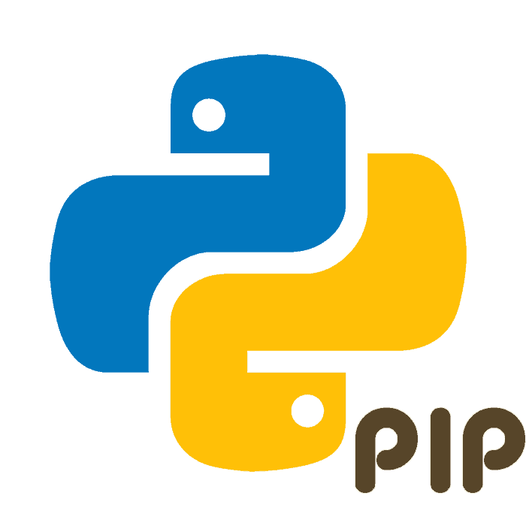


npm
npm is the package manager for Node.js, analogous to:
https://www.npmjs.com/

Slide 4


npm
There are several alternatives, like Yarn and Turbo, but npm is automatically installed when you install Node.js

Slide 5

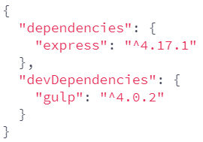







npm
When you run npm install, npm loads the package.json file from your current directory, and installs all dependencies listed in package.json
npm install

Slide 6
npm
In addition to dependencies:
devDependencies - these dependencies are not necessary to run this project in production, npm install --production will skip them;
peerDependencies - only useful if you are building a library that other Node.js projects will npm install
optionalDependencies - normally, npm install will fail if it can't find the package you're trying to install
bundledDependencies - defines an array of package names that will be bundled when publishing the package

Slide 7
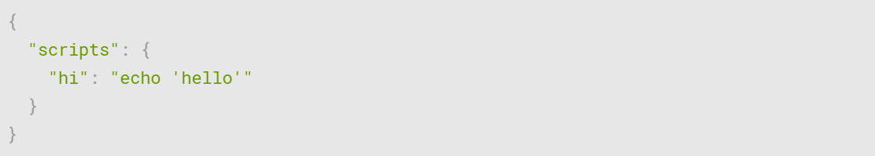
npm
The scripts property in package.json lets you define custom scripts that you can then run using npm run

Slide 8
React Online Marathon

Slide 9

Tools

Slide 10
TypeScript
TypeScript offers all of JavaScript’s features, and an additional layer on top of these: TypeScript’s type system
https://www.typescriptlang.org/
error

Slide 11


TypeScript
TypeScript Compiller
“Transpilling”
ts
js

Slide 12
TypeScript
command line
Use options:

Slide 13
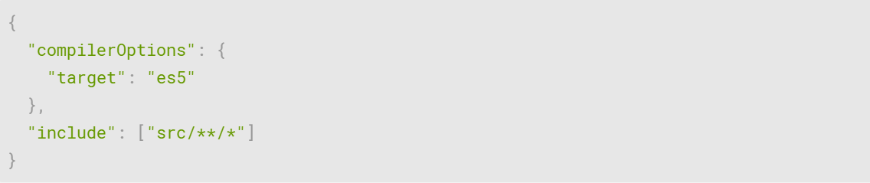
TypeScript
config file
(tsconfig.json)
Use options:

Slide 14
React Online Marathon

Slide 15

Tools

Slide 16

Gulp
Gulp is a cross-platform task runner that lets developers automate many development tasks,
analogous to:
https://gulpjs.com/

Slide 17
Gulp
gulp-minify-css
Gulp reads files as streams and pipes the streams to different tasks. These tasks are code-based and use plugins. The tasks modify the files, building source files into production files.
gulp-concat
Input
Read Files
Modify Files
Modify Files
Output
Write Files
Modify Files

Slide 18
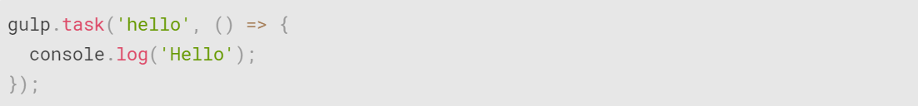
Gulp
A gulpfile is a file in your project directory titled gulpfile.js (or capitalized as Gulpfile.js), that automatically loads when you run the gulp command

Slide 19
React Online Marathon

Slide 20

Tools

Slide 21

Browserify
Browserify allows us to use node.js style modules in the browser.
http://browserify.org/
require
require
require

Slide 22
Browserify
Browserify allows us to use node.js style modules in the browser. We define dependencies and then Browserify bundles it all up into a single neat and tidy JavaScript file
require
require
require

Slide 23
React Online Marathon

Slide 24

Tools

Slide 25
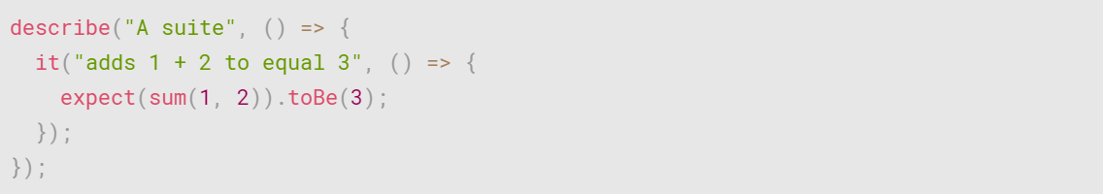
Jasmine
Jasmine is a behavior-driven development framework for testing JavaScript code.
https://jasmine.github.io/

Slide 26
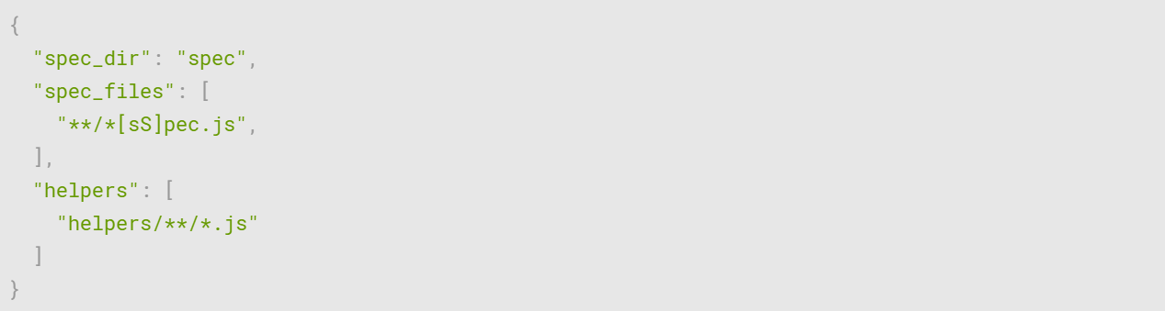
Jasmine
Customize spec/support/jasmine.json to enumerate the source files and spec files you would like the Jasmine runner to include

Slide 27
Jasmine
Path to your configuration file can be used as an option or set as an environment variable

Slide 28
React Online Marathon

Slide 29

Tools

Slide 30
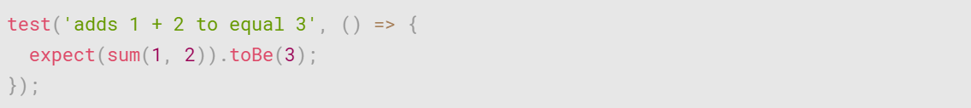
Jest
Jest is a JavaScript testing framework with a focus on simplicity
https://jestjs.io/

Slide 31
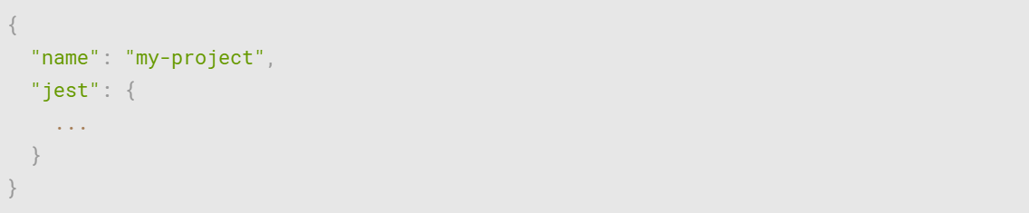
Jest
Jest's configuration can be defined in the package.json

Slide 32
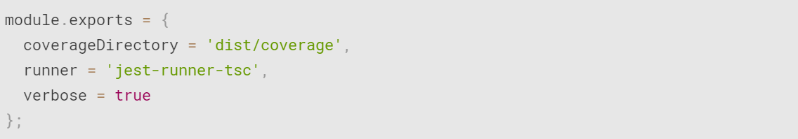
Jest
or through a jest.config.js

Slide 33
Jest
or through the --config option with path to file.js|cjs|mjs|json

